Slide 1

CERTIFICATE III IN AUTOMOTIVE REPAIR & MAINTENANCE
SUBJECT: VEHICLE MAINTENACE AND REPAIR
By Ibrahim siraj
Maldives polytechnic

Slide 2

VEHICLE MAINTENACE AND REPAIR
Chapter 2 Move, Position and Park Vehicle
Common types of car on road
By Ibrahim siraj
Maldives polytechnic

Slide 3
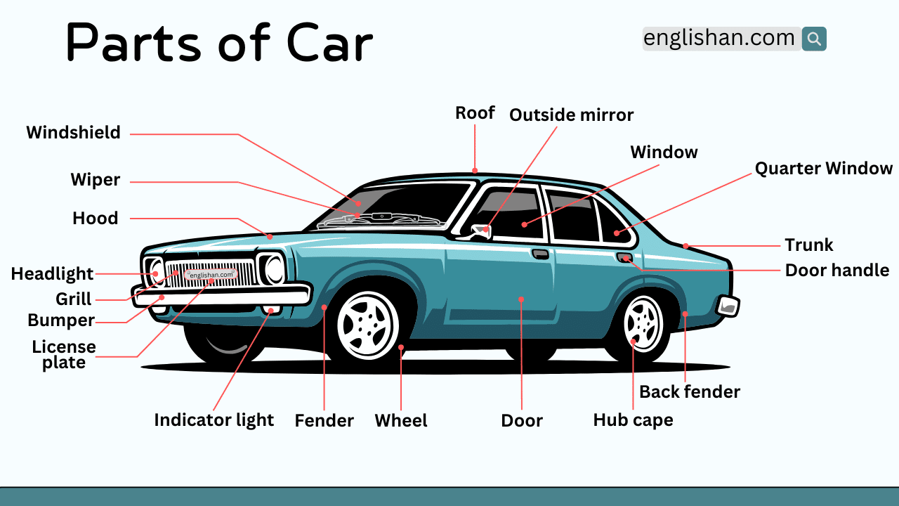
VEHICLE MAINTENACE AND REPAIR
Chapter 2 Move, Position and Park Vehicle
Parts of car
By Ibrahim siraj
Maldives polytechnic

Slide 4

VEHICLE MAINTENACE AND REPAIR
Chapter 2 Move, Position and Park Vehicle
Common Car brands
By Ibrahim siraj
Maldives polytechnic

Slide 5
VEHICLE MAINTENACE AND REPAIR
Chapter 2 Move, Position and Park Vehicle
Proper way to move vehicle
To move a vehicle, you can drive it yourself or have it transported by professionals. Driving involves operating the engine, clutch, gas, and brake pedals while steering, whereas professional transport uses services like auto transport companies or drivers who handle the move for you
Manual transmission:
Ensure the vehicle is in neutral with the handbrake on, then start the engine.
Press the clutch all the way down and select first gear.
Gently press the gas pedal to about \(1,500\) revs, then slowly lift the clutch to the "biting point" where you feel the engine sound change.
Release the handbrake, and as the car starts to move, slowly lift the clutch completely while applying a little more gas to accelerate.
By Ibrahim siraj
Maldives polytechnic

Slide 6
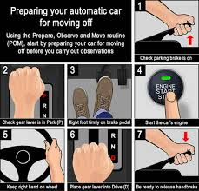
VEHICLE MAINTENACE AND REPAIR
Chapter 2 Move, Position and Park Vehicle
Proper way to move vehicle
To move a vehicle, you can drive it yourself or have it transported by professionals. Driving involves operating the engine, clutch, gas, and brake pedals while steering, whereas professional transport uses services like auto transport companies or drivers who handle the move for you
Automatic transmission:
Press the brake paddle and Start the engine.
Shift the gear selector into "Drive".
Release the parking brake and the foot brake, and gently press the gas pedal to move forward.
By Ibrahim siraj
Maldives polytechnic

Slide 7
VEHICLE MAINTENACE AND REPAIR
Chapter 2 Move, Position and Park Vehicle
Proper way to move vehicle
Transporting the vehicle with a professional service
This method is for moving a vehicle long distances without driving it.
Hiring a company: Research and choose an auto transport company that offers open or enclosed carrier transport, or a company that can find a driver for you.
Preparing the vehicle: Clean the car, remove personal items, document its condition, and check tire pressure and fluids before transport.
Logistics: Schedule a pick-up and delivery date. The company will provide an estimate based on the vehicle's size and distance
By Ibrahim siraj
Maldives polytechnic

Slide 8
VEHICLE MAINTENACE AND REPAIR
Chapter 2 Move, Position and Park Vehicle
Proper way to move vehicle
Key considerations for both methods
Manual vs. automatic: The steps for moving a manual car involve coordinating the clutch, gas, and brake pedals, while an automatic car is simpler.
Safety and preparation: Before driving, ensure you are in a safe position, the car is properly prepared, and you have the necessary documents. For transport, thorough preparation minimizes risks
By Ibrahim siraj
Maldives polytechnic

Slide 9
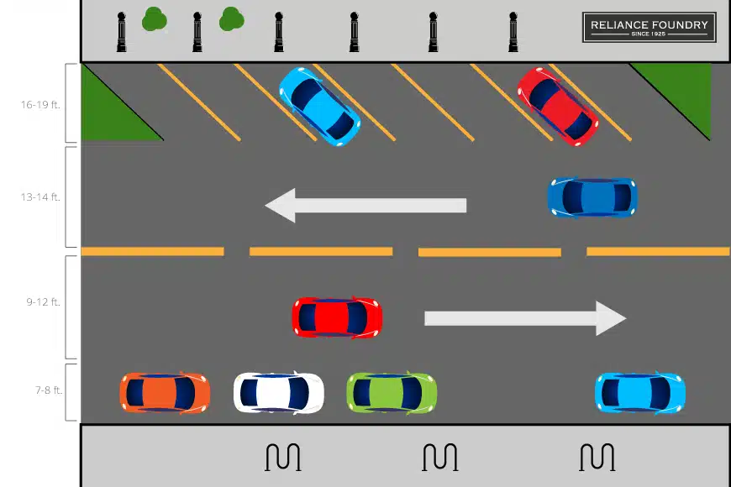
VEHICLE MAINTENACE AND REPAIR
Chapter 2 Move, Position and Park Vehicle
Position and Park Vehicle
To position and park a vehicle, slowly signal and approach the space, aligning your car appropriately (e.g., parallel to the curb with about two feet of space for parallel parking). Then, maneuver into the spot, using your mirrors and checking blind spots to stay centered within the lines. Finally, secure the vehicle by engaging the parking brake and shifting into "Park" or gear before turning off the engine
By Ibrahim siraj
Maldives polytechnic

Slide 10
VEHICLE MAINTENACE AND REPAIR
Chapter 2 Move, Position and Park Vehicle
General Parking Steps
Find a suitable, legal spot: Look for a space that provides enough room for your car to fit without hitting other vehicles or obstacles, and check for any parking restrictions or signs.
Signal your intention: Alert other drivers and pedestrians that you plan to park by using your turn signal.
Position your vehicle: Maneuver your car to the appropriate starting position for the specific type of parking you are performing.
Check mirrors and blind spots: Continuously check for traffic, pedestrians, or other obstacles around your vehicle before and during the maneuver.
Maneuver slowly: Turn the steering wheel as needed while moving at a very slow speed, making small corrections to enter the spot correctly.
Straighten out: Once in the spot, align your tires so the car is centered and parallel to the lines or curb.
Secure the vehicle: Engage the parking brake, shift into park (P) for automatic cars or neutral for manual, turn off the engine, and remove the key.
By Ibrahim siraj
Maldives polytechnic

Slide 11
VEHICLE MAINTENACE AND REPAIR
Chapter 2 Move, Position and Park Vehicle
Perpendicular Parking (Head-In or Back-In) Steps
Head-In:
Position your car so there is enough room to make a wide turn into the spot.
When your side mirror is in line with the first line of the bay you want to enter, turn your steering wheel to full lock in the direction of the spot.
Slowly pull in, straightening the wheel once your car is aligned within the lines.
Back-In (Safer when exiting):
Drive past the space and position your vehicle so it is adjacent to the one you want to reverse into, leaving about 3 feet of space.
Shift into reverse, check your surroundings, and turn the steering wheel to full lock toward the space.
Slowly back up, using both side mirrors to guide yourself between the lines. Straighten the wheel when your car is aligned with the two adjacent vehicles
By Ibrahim siraj
Maldives polytechnic

Slide 12
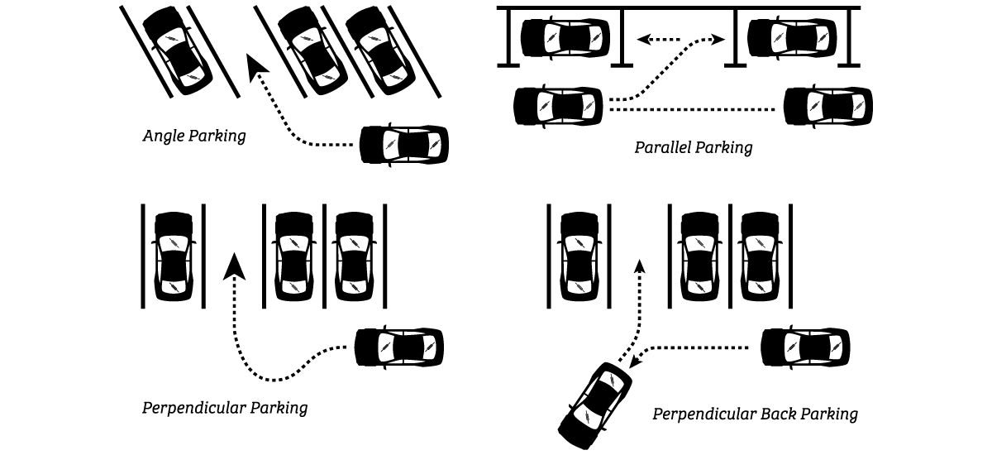
VEHICLE MAINTENACE AND REPAIR
Chapter 2 Move, Position and Park Vehicle
Perpendicular Parking (Head-In or Back-In) Steps
Angle Parking
Angle parking is simpler and often used in small lots with diagonal spaces.
Signal and approach the space at a slow speed, ensuring you angle your car towards the spot.
Slowly drive in, straightening the wheel once you are halfway into the spot.
Ensure your car is centered and not sticking out into the driving lane
By Ibrahim siraj
Maldives polytechnic

Slide 13
VEHICLE MAINTENACE AND REPAIR
Chapter 2 Move, Position and Park Vehicle
Perpendicular Parking (Head-In or Back-In) Steps
Parallel Parking
Find a spot at least 1.5 times the length of your car.
Position your car parallel to the car in front of the empty space, about 2-3 feet away, with your rear bumpers aligned.
Shift into reverse, turn your steering wheel fully towards the curb, and reverse slowly.
Stop when your car is at about a 45-degree angle to the curb or when you see the car behind you in your left side mirror.
Straighten your wheels and continue reversing straight back until your front bumper clears the rear bumper of the car in front.
Turn the wheel fully away from the curb (e.g., to the left for a right-side park) and continue to reverse slowly until you are in the spot and parallel to the curb.
Adjust by moving forward or backward to center your vehicle in the space.
By Ibrahim siraj
Maldives polytechnic

Slide 14
VEHICLE MAINTENACE AND REPAIR
Chapter 2 Move, Position and Park Vehicle
Perpendicular Parking (Head-In or Back-In) Steps
Step-by-Step Lifting Procedure (using a floor jack and jack stands)
Prepare the Vehicle and Area: Park the vehicle on a level surface, engage the parking brake, and chock the uplifted wheels.
Position the Jack: Place the jack beneath the designated jacking point. Ensure the jack pad is centered and sitting flat on the ground.
Raise the Vehicle Slowly: Lift the vehicle gradually, watching for any signs of instability or shifting. Raise it just high enough to place the jack stands and perform your maintenance work.
Insert Jack Stands: Once the vehicle is at the desired height, place jack stands under the vehicle's designated support points (typically on the frame or axle, as specified in the manual).
Lower onto Stands: Slowly and carefully lower the vehicle so its weight rests securely on the jack stands, not the jack itself.
Perform Stability Check: Give the vehicle a gentle push or shake to confirm it is stable and secure on the jack stands before getting underneath it.
Conduct Maintenance: Once stability is confirmed, you can safely work under the vehicle.
Remove Stands and Lower: When finished, raise the vehicle slightly with the jack so the stands can be removed easily. Pull the stands out, and then slowly lower the vehicle completely to the ground
By Ibrahim siraj
Maldives polytechnic

Slide 15
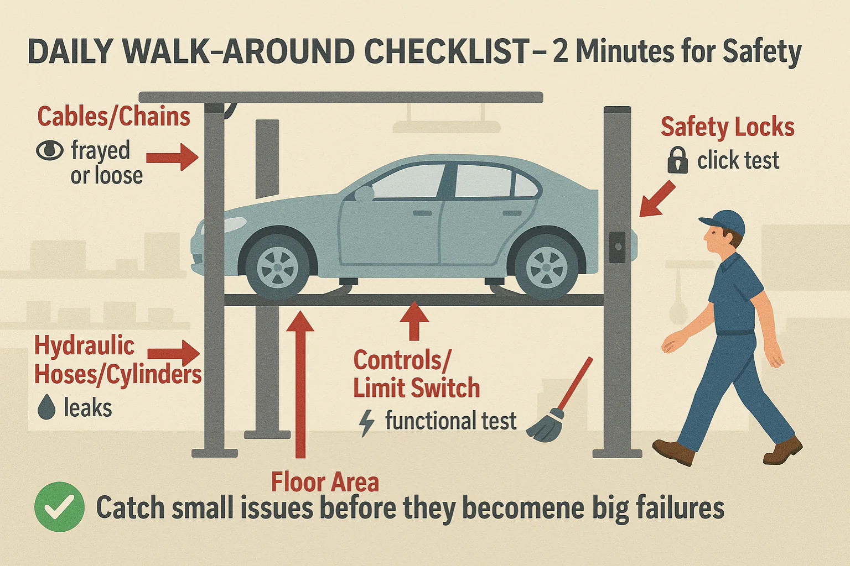
VEHICLE MAINTENACE AND REPAIR
Chapter 2 Move, Position and Park Vehicle
Perpendicular Parking (Head-In or Back-In) Steps
Step-by-Step Lifting Procedure (using a floor jack and jack stands)
By Ibrahim siraj
Maldives polytechnic

Slide 16
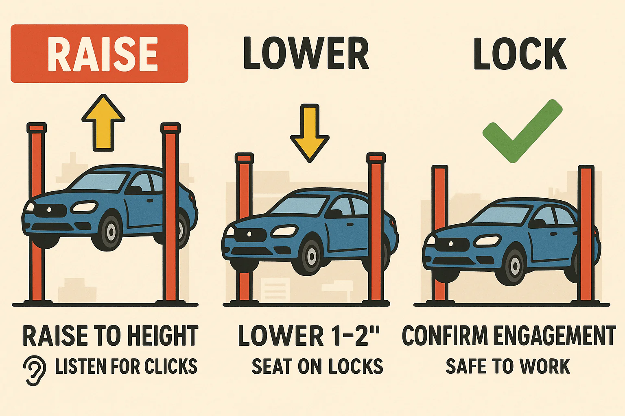
VEHICLE MAINTENACE AND REPAIR
Chapter 2 Move, Position and Park Vehicle
Perpendicular Parking (Head-In or Back-In) Steps
Step-by-Step Lifting Procedure (using a floor jack and jack stands)
By Ibrahim siraj
Maldives polytechnic

Slide 17
VEHICLE MAINTENACE AND REPAIR
Chapter 2 Move, Position and Park Vehicle
Vehicle Intake & Safe Parking Protocol
Arrival & Inspection
Essential Customer Details
Contact Information: Full name, mobile number (ask if they prefer SMS/WhatsApp updates), and email address.
Preferred Communication: How they want to be reached for extra repair approvals.
Payment Method: Confirm if it is a cash, card, or insurance-based repair
Precise Vehicle Information
Identification: Record the Make/Model, Year, License Plate, and VIN (Vehicle Identification Number). For your Mazda Demio
, this includes specific codes like DBA-DEJFS to ensure you order correct "Skyactiv" specific parts.
Status: Current Odometer reading (mileage) and current fuel level.
Inventory Checklist: Check for items left in the car like the spare wheel, jack, tools, or floor mats to prevent later disputes
By Ibrahim siraj
Maldives polytechnic

Slide 18
VEHICLE MAINTENACE AND REPAIR
Chapter 2 Move, Position and Park Vehicle
Vehicle Intake & Safe Parking Protocol
Arrival & Inspection
Essential Customer Details
Detailed "Complaint" or "Job Request"
The Issue: Ask the customer to describe the problem in their own words (e.g., "squeaking noise when turning").
Symptom Details: Ask when the issue happens (e.g., only when cold, at high speeds, or when braking) to help the mechanic diagnose faster.
Visual Inspection: Walk around the car with the customer and mark any existing scratches, dents, or cracked lights on the intake form before they leave.
By Ibrahim siraj
Maldives polytechnic

Slide 19
VEHICLE MAINTENACE AND REPAIR
Chapter 2 Move, Position and Park Vehicle
Vehicle Intake & Safe Parking Protocol
Arrival & Inspection
Essential Customer Details
Digital Tools to Use
You can use templates from sites like the Jotform Vehicle Maintenance Template or SafetyCulture Job Cards to create professional digital or paper forms for your workshop.
By Ibrahim siraj
Maldives polytechnic

Slide 20
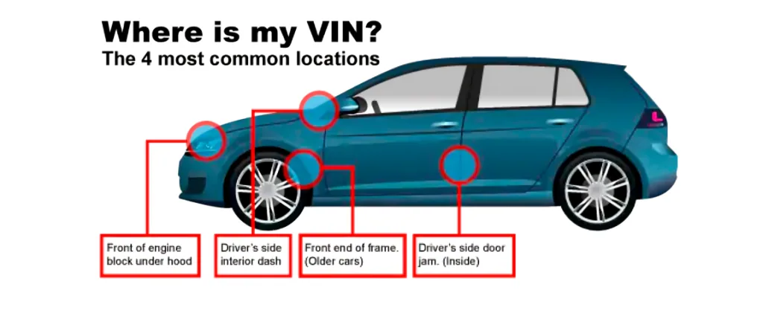
VEHICLE MAINTENACE AND REPAIR
Chapter 2 Move, Position and Park Vehicle
Vehicle Intake & Safe Parking Protocol
Arrival & Inspection
Conduct a visual check for pre-existing damage as the vehicle enters the service bay
By Ibrahim siraj
Maldives polytechnic

Slide 21
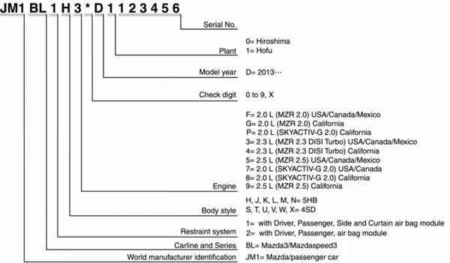
VEHICLE MAINTENACE AND REPAIR
Chapter 2 Move, Position and Park Vehicle
Vehicle Intake & Safe Parking Protocol
Arrival & Inspection (Find car information)
By Ibrahim siraj
Maldives polytechnic

Slide 22
VEHICLE MAINTENACE AND REPAIR
Chapter 2 Move, Position and Park Vehicle
Vehicle Intake & Safe Parking Protocol
Arrival & Inspection
DBA DEJFS 28W L21
Mazda Demio Skyactive
DBA: Indicates the vehicle meets specific Japanese emission standards (Low Emissions Vehicle).
DE: Refers to the chassis series (3rd Generation Demio)
JFS: Specifically identifies the 1.3-liter 13-Skyactiv variant
Engine: 1.3L P3-VPS DOHC engine.
Transmission: Continuously Variable Transmission (CVT)
28W: Exterior Paint Code
L21: Interior Trim Code
This code specifies the material and color configuration used inside the cabin
Trim Type: It designates a Black interior system.
Typical Features: This often includes dark seat upholstery and matching dashboard/door paneling common to the "13-Skyactiv" grade
By Ibrahim siraj
Maldives polytechnic

Slide 23
VEHICLE MAINTENACE AND REPAIR
Chapter 2 Move, Position and Park Vehicle
Vehicle Intake & Safe Parking Protocol
Arrival & Inspection
Safe Positioning:
Level Ground: Always park on a level surface with a maximum 2% grade to prevent involuntary movement.
Forward-Only Movement: Position the vehicle so the first movement after service is forward, minimizing risky reversing.
Transmission: Shift to Park (P) for automatics or a low gear for manuals.
Isolation: Fully engage the parking brake and use wheel chocks for heavy vehicles or when jacking.
Conduct a visual check for pre-existing damage as the vehicle enters the service bay
Maintenance Work plan - Phase 1: Pre-Service
Asset Overview: List the vehicle's past repair history and specific model requirements.
Resource Staging: Identify necessary tools (jacks, stands, scan tools) and spare parts before beginning.
Safety Prep: Ensure emergency equipment like fire extinguishers and first aid kits are accessible in the bay.
By Ibrahim siraj
Maldives polytechnic

Slide 24
VEHICLE MAINTENACE AND REPAIR
Chapter 2 Move, Position and Park Vehicle
Vehicle Intake & Safe Parking Protocol
Arrival & Inspection
Conduct a visual check for pre-existing damage as the vehicle enters the service bay
Phase 2: Execution & Routine Tasks
Daily "WOFT" Checks: Use the acronym Water, Oil, Fan belt, and Tires for basic daily maintenance.
Preventive Milestones:
Fluid Service: Drain/refill engine oil and check coolant levels (only when the engine is cool).
System Diagnostics: Inspect brakes (liners/pads), steering mechanisms, and electrical systems (lights/wipers).
Tire Health: Check pressure, tread depth, and wheel nut tightness.
By Ibrahim siraj
Maldives polytechnic

Slide 25
VEHICLE MAINTENACE AND REPAIR
Chapter 2 Move, Position and Park Vehicle
Vehicle Intake & Safe Parking Protocol
Arrival & Inspection
Conduct a visual check for pre-existing damage as the vehicle enters the service bay
Phase 2: Execution & Routine Tasks
Daily "WOFT" Checks: Use the acronym Water, Oil, Fan belt, and Tires for basic daily maintenance.
Preventive Milestones:
Fluid Service: Drain/refill engine oil and check coolant levels (only when the engine is cool).
System Diagnostics: Inspect brakes (liners/pads), steering mechanisms, and electrical systems (lights/wipers).
Tire Health: Check pressure, tread depth, and wheel nut tightness.
By Ibrahim siraj
Maldives polytechnic

Slide 26
VEHICLE MAINTENACE AND REPAIR
Chapter 2 Move, Position and Park Vehicle
Vehicle Intake & Safe Parking Protocol
Arrival & Inspection
Phase 3: Post-Service & Handover
Quality Control: A supervisor or second technician should verify that all "holds in park" and safety lights function correctly.
Workplace Restoration: Clear the parking bay of debris or spills (like slippery coolant) to maintain a safe shop environment.
Record Keeping: Log all parts replaced and services performed into the Vehicle Maintenance Log to track future service intervals.
Recommended Slide Templates
Professional Layouts: Utilize templates like the Vehicle Maintenance PowerPoint or Auto Repair Illustration to visually map your workflow.
Checklist Examples: Refer to the FRSC Maintenance Guide for structured safety acronyms and diagrams.
Would you like a more detailed technical checklist for specific components like the braking system or engine management
Conduct a visual check for pre-existing damage as the vehicle enters the service bay
By Ibrahim siraj
Maldives polytechnic

Slide 27
THANK YOU

